Slide 1

Coffee Sales Performance Review: Strategic Insights & Recommendations
Mirko Laine Dashboard Analysis

Slide 2
Agenda
Executive Summary – Key Findings at a Glance
Sales Evolution Over Time (2019-2022)
Performance by Coffee Type
Who Are Our Power Buyers
Sales Distribution by Country
Impact of Loyalty Card on Sales
Path Forward – Key Strategic Moves

Slide 3
Executive Summary
Top Insights
1. 2021 marked peak sales performance
2. Revenue Concentration in top 5 customers
3. U.S leads with outsized market share
4. Seasonality drives volatility
Sales volumes reached their highest point, driven by strong performance in Arabica and Robusta Categories.
Top 5 individual buyers contributed over 1470$, indication dependency on key accounts.
United States generated 35 639$ in revenue, which is 5x more than the next largest country Ireland.
Sales data reveals clear seasonal demand spikes, offering opportunities for campaign

Slide 4
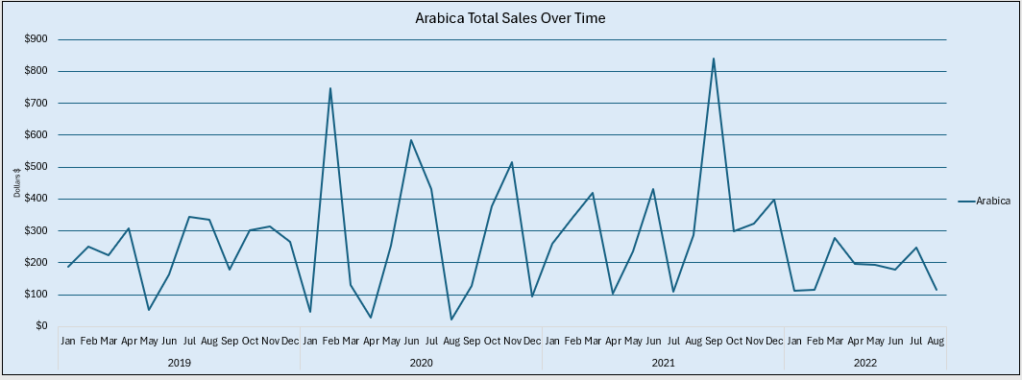
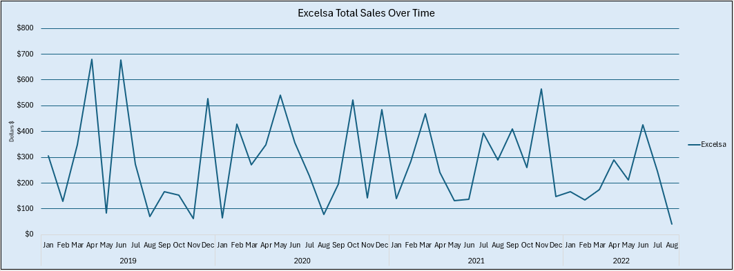
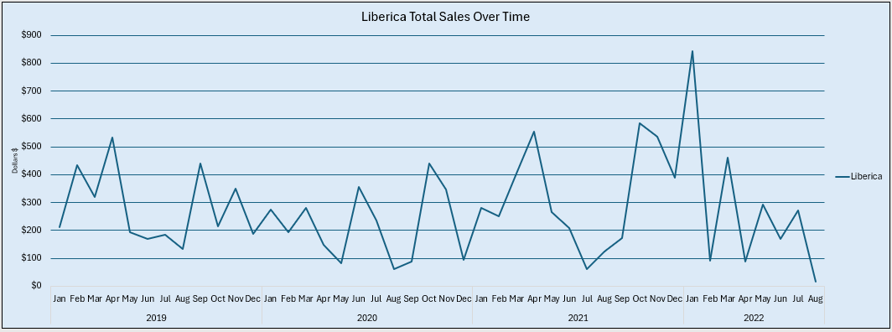
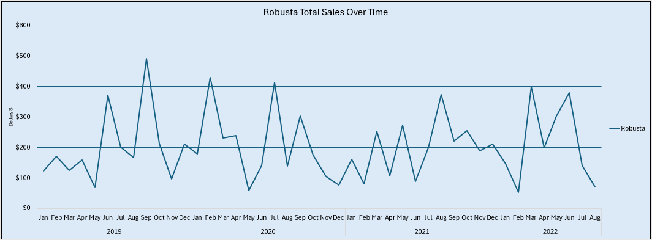
Sales Evolution Over Time (2019–2022)
Arabica
Excelsa
Liberica
Robusta

Slide 5
Sales Evolution Over Time (2019–2022)
Key Takeaways
Seasonal peaks drive sales cycles Consistent spikes in spring/summer months highlight the importance of aligning promotions with high-demand periods.
2. Clear COVID-19 impact and recovery trajectory 2020 shows a notable dip, followed by steady recovery through 2021, culminating in peak performance.
3. Arabica outperforms with stability Among the coffee types, Arabica shows steady performance, while Excelsa fluctuates—suggesting demand inconsistency or supply sensitivity.

Slide 6
Performance by Coffee Type
Key Takeaways
Excelsa leads total revenue ($12.3K), driven by high seasonal peaks, suggest strong customer preference in specific periods; considering targeted promotions and inventory planning.
Liberica slightly trails Excelsa ($12.1K), despite sales volatility; potential for growth if stabilized through pricing, bundling or loyalty incentives.
Arabica delivers consistent baseline revenue ($11.8K) with lower volatility, optimal for core range anchoring and supply reliability.
Robusta underperforms ($9.0K), indicating weak customer traction. Thus, re-evaluate shelf space, marketing or consider phase-out unless strategic need exists.
Strategic Recommendation
Shift resources toward Excelsa and Arabica to maximize short-term gains and long-term consistency. Reassess Robusta’s role in portfolio and investigate Liberica's volatility to unlock stable revenue upside.

Slide 7
Revenue vs. Reliability: How Coffee Types Differ in Strategic Value
Coffee Type | Line Chart (Stability) | Bar Chart (Total Revenue) | Business Insight
Excelsa | Volatile and spiky | Highest | High peaks drive revenue. Worht promoting in key seasons
Liberica | Volatile and inconsistent | Second Highest | Underlying potential, but investigate margin/campaigns
Arabica | Stable and reliable | Third | Consistent baseline sales, ideal for core offering
Robusta | Low and flat | Lowest | Underperforming, assess market fit or pricing
Excelsa and Liberica outperform in total sales, but their revenue depends on seasonal peaks — indicating promotional or external demand drivers. Arabica provides stable revenue, suggesting suitability for long-term strategic focus. Robusta’s underperformance may require repositioning or discontinuation.

Slide 8
Key Customer Insights – Understanding Our Power Buyers
Top Customer Contribution
Allis Wilmore and Brenn Dundrede are the top 2 customers, contributing ~€624 combined.
Total value from Top 5 customers is €1,470+, suggesting revenue is heavily concentrated among a few buyers.
Loyalty Leverage Opportunity
Not all top buyers use loyalty cards, indicating room to:
Strengthen loyalty program adoption
Introduce exclusive tiers or perks for high-value customers
Use loyalty to shift one-time buyers into repeat purchasers
Strategic Takeaway
Customer retention and expansion strategies should prioritize top 5 buyers.
Data supports the case for personalized campaigns, bundling, or early access offers.

Slide 9
Market Concentration Analysis – Geographic Revenue Breakdown
Heavy Revenue Concentration
The United States contributes approximately €35,639, representing 75%+ of total revenue.
High dependency on a single market poses risk if demand shifts or competition intensifies.
Untapped Market Potential
Ireland (€6,697) and the United Kingdom (€2,799) account for a small portion of sales.
Indicates limited market reach or ineffective targeting in these geographies.
Strategic Recommendation
Pursue differentiated country strategies:
United States: Maintain leadership with retention and upselling strategies.
Ireland/UK: Launch awareness campaigns and tailor value propositions.
Consider pricing localization, loyalty offers, or regional partnerships.
Key Insight: While the U.S. drives most revenue, growth will depend on unlocking value in secondary markets. A tailored approach by region is essential for sustainable expansion.

Slide 10
Loyalty Cards: A Lever for Revenue Growth?
1. Loyalty Card Customers Spend More per Order
Although loyalty card users make up only 46.35% of purchases, they generate nearly €20,918 in revenue.
Their average basket size is significantly higher than non-users.
Indicates potential for higher Customer Lifetime Value (CLV) among loyal customers.
3. Business Opportunity: Unlock Revenue in Underpenetrated Regions
Expand loyalty initiatives in Ireland and the U.K., where adoption remains low.
Incentivize sign-ups with exclusive discounts, tiered benefits, or referral bonuses.
Use successful U.S. strategy as a model for other markets.
Conclusion:
Loyalty card users generate disproportionately high revenue despite lower transaction count. Scaling the program into underperforming regions could unlock incremental sales and deepen customer engagement.
2. Adoption Remains Concentrated in the U.S.
Over 70% of all loyalty card usage occurs in the U.S. market.
Ireland and the U.K. lag significantly in both adoption and spend.
Suggests untapped growth potential in these geographies.
Loyalty Card | Sales % | Sales $
No | 53.65% | $24,216.41
Yes | 46.35% | $20,917.85

Slide 11
strategic Conclusions & Path Forward
Key Takeaways:
Revenue driven by seasonal peaks and top performers: Arabica and Excelsa emerged as revenue leaders, with Excelsa showing strong seasonal gains and Arabica offering stable long-term performance.
Heavy dependence on U.S. market & power buyers: Over 75% of revenue comes from the U.S. and just 5 key customers — a clear concentration risk that requires diversification.
Loyalty card program delivers value but lacks reach: Loyalty card users generate higher revenue per transaction, but adoption outside the U.S. is low — expansion could unlock additional growth.
Strategic Imperatives:
Expand loyalty program to Ireland and the U.K. using incentives and segmentation.
Balance short-term gains with long-term stability by promoting Excelsa while securing Arabica supply and pricing.
Develop tailored country playbooks to reduce geographic over-dependence and increase customer acquisition in secondary markets.
Strengthen key account management for high-value customers and replicate their behavior in broader segments.

Slide 12

Thank you!

